Slide 1
Secure Data Hiding in Image Using Steganography
CAPSTONE PROJECT
Presented By: Shebin Shouckath Kolliyath
Student Name: Shebin Shouckath Kolliyath
College Name & Department: College of Engineering Kidangoor & Computer Science and Engineering

Slide 2
OUTLINE
Problem Statement
Technology used
Wow factor
End users
Results
Conclusion
Git-hub Link
Future scope

Slide 3
Problem Statement
Current Limitations in Image Steganography:
Weak Security: Most tools use basic LSB (Least Significant Bit) techniques without encryption, exposing hidden data to extraction.
Data Corruption: Lossy formats (e.g., JPEG) degrade embedded payloads during encoding.
Tampering Risks: No mechanism to detect unauthorized modifications to hidden messages.
Complexity: Tools lack intuitive interfaces for non-technical users.
StegoHelix Addresses These By:
Image Processing (OpenCV)
Web GUI (Streamlit)
Embedding encrypted messages into lossless PNGs while ensuring end-to-end security and usability.

Slide 4
Technology used
Libraries & Frameworks:
OpenCV: Pixel-level image manipulation for precise LSB embedding.
Streamlit: Simplifies GUI development with pre-built components (file uploaders, tabs).
ChaCha20-Poly1305: Encrypts messages with 256-bit security + authentication tags.
Argon2: Derives encryption keys resistant to brute-force/GPU attacks.
numpy: Efficiently converts payloads to bitstreams for LSB insertion.
Platforms:
Python 3.10+: Core backend logic.
Streamlit Cloud: Hosts the live web app for global access.

Slide 5
Wow factors
Military-Grade Encryption:
ChaCha20-Poly1305 (used by VPNs like WireGuard) encrypts messages before embedding.
Tamper Detection:
Poly1305 MAC tag verifies message integrity during decoding.
Lossless Stealth:
PNG format retains 100% image quality post-embedding.
Quantum-Safe Keys:
Argon2 hashing defeats brute-force attacks, even with GPUs/ASICs.
Instant Deployment:
Streamlit app runs in any browser with 3 clicks (upload → encode → download).

Slide 6
End users
Journalists/Activists:
Bypass surveillance by hiding messages in social media images.
Healthcare Professionals:
Securely embed patient records in medical scans (e.g., X-rays).
Enterprises:
Protect trade secrets in corporate graphics (e.g., infographics).
Military/Defense:
Conceal mission-critical data in satellite/drone imagery.

Slide 7
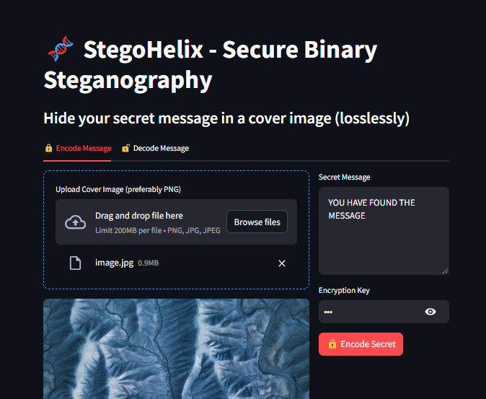
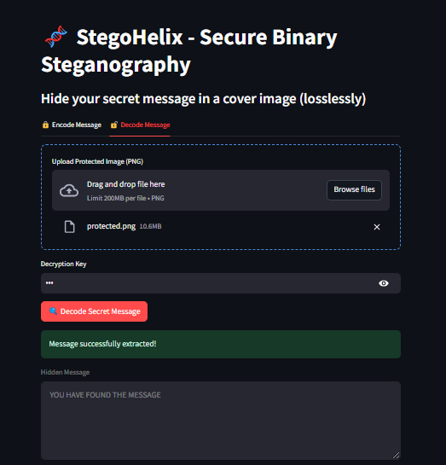
Results: UI Overview
Encoding Interface
Decoding Interface

Slide 8
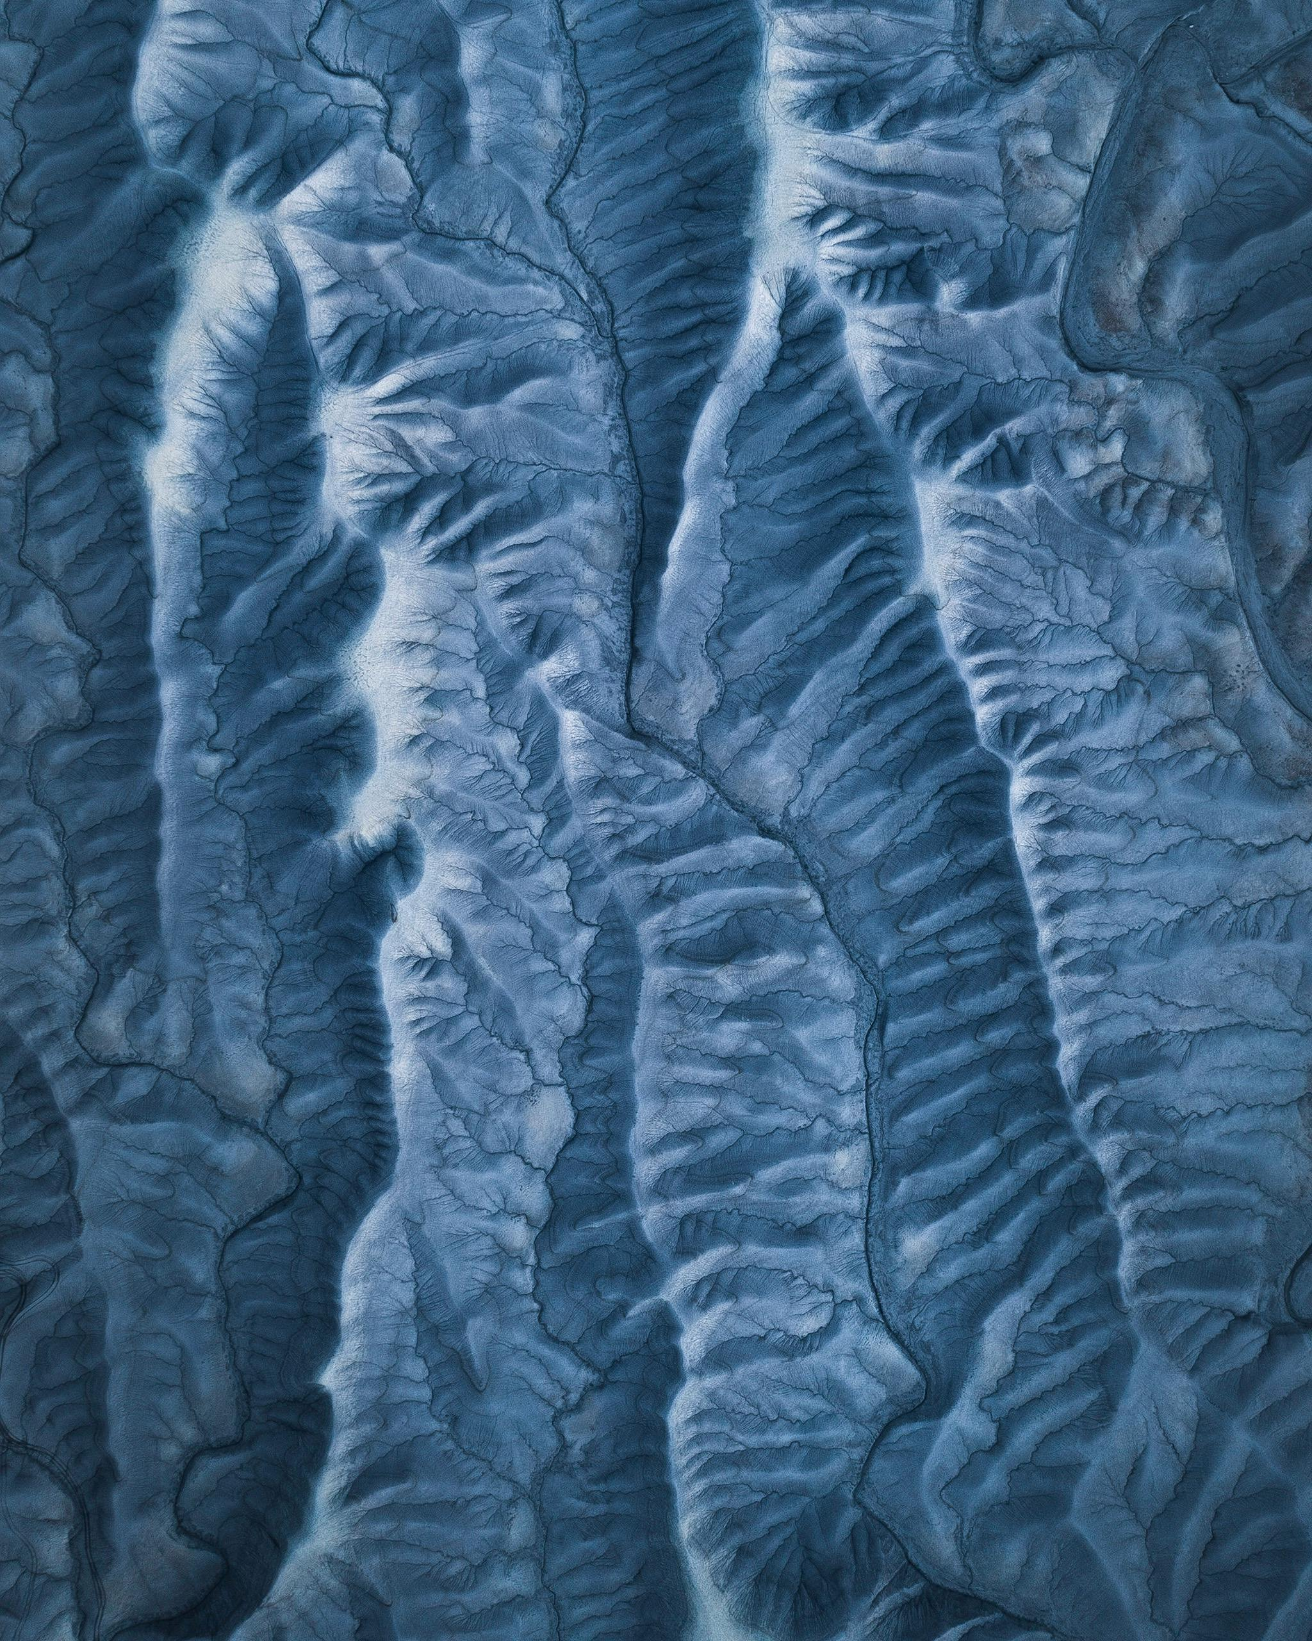

Results: Image Comparison
PASS: KEY
Original Image
Steganographic Image

Slide 9
Conclusion
StegoHelix Achieves:
Security: Unreadable encrypted payloads + tamper-proof design.
Stealth: Zero visual/statistical anomalies in encoded images.
Simplicity: Accessible to users with no technical background.
Impact:
Redefines secure communication by making hidden data truly invisible and unbreakable.

Slide 10
GitHub Link
Repository: https://github.com/dark-vpr/StegoHelix.git
README File: Includes setup instructions, technical docs, and usage examples.
Code Structure:
src/encoder.py: Embeds encrypted payloads into LSBs.
src/decoder.py: Extracts and decrypts messages.
app.py: Streamlit frontend.

Slide 11
Future scope
Multi-Channel Embedding
Use RGB + Alpha channels (PNG) to increase payload capacity without visual artifacts.
Example: Hide 4x more data by utilizing all 4 channels.
Adaptive Pixel Selection
Embed data only in high-frequency regions (e.g., textured areas) to evade steganalysis tools.
Method: Use edge detection (Canny algorithm) to identify "safe" pixels.
Image-Based Key Generation
Derive encryption keys from image features (e.g., histogram patterns) instead of passwords.
Benefit: Eliminate password memorization while enhancing security.
Anti-Forensic Techniques
Add decoy payloads to confuse steganalysis tools.
How: Embed fake messages in easily detectable LSBs to mask the real payload.

Slide 12
THANK YOU

